Slide 1

Agrivision

Slide 2
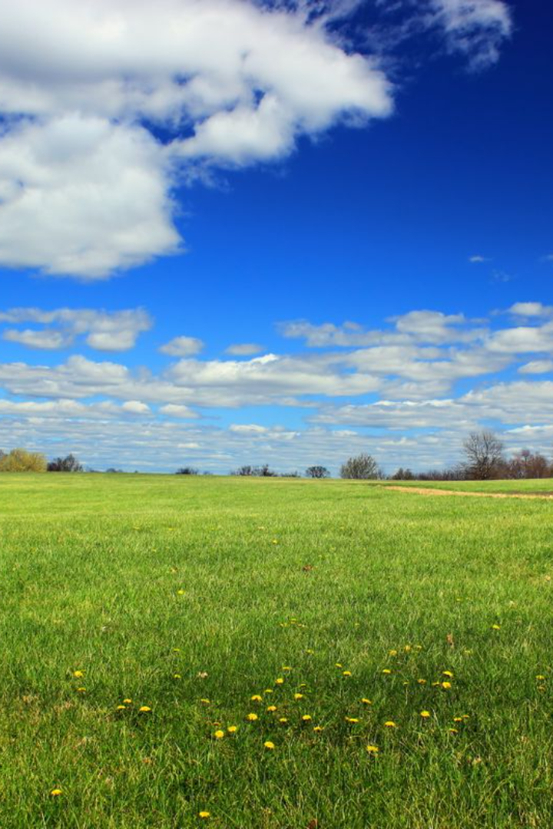
Challenges That Farmers Face When Selling Their Crop
Farmers encounter numerous obstacles when it comes to selling their crop. From crop spoilage to market information gaps, let's explore the common problems and potential solutions.

Slide 3

Agrivision: Innovating Agricultural Solutions
1
Sustainable Farming
2
Advanced Technology
Agrivision is committed to promoting sustainable farming practices that reduce crop spoilage and increase yields. We offer a range of solutions to help farmers achieve their goals.
Our cutting-edge technology is designed to improve crop storage, transportation, and harvesting. We're constantly developing new tools and techniques to help farmers maximize their profits.
3
Expert Support
Agrivision's team of experts is available to help farmers with everything from crop planning to post-harvest handling. We're dedicated to helping our customers succeed.

Slide 4
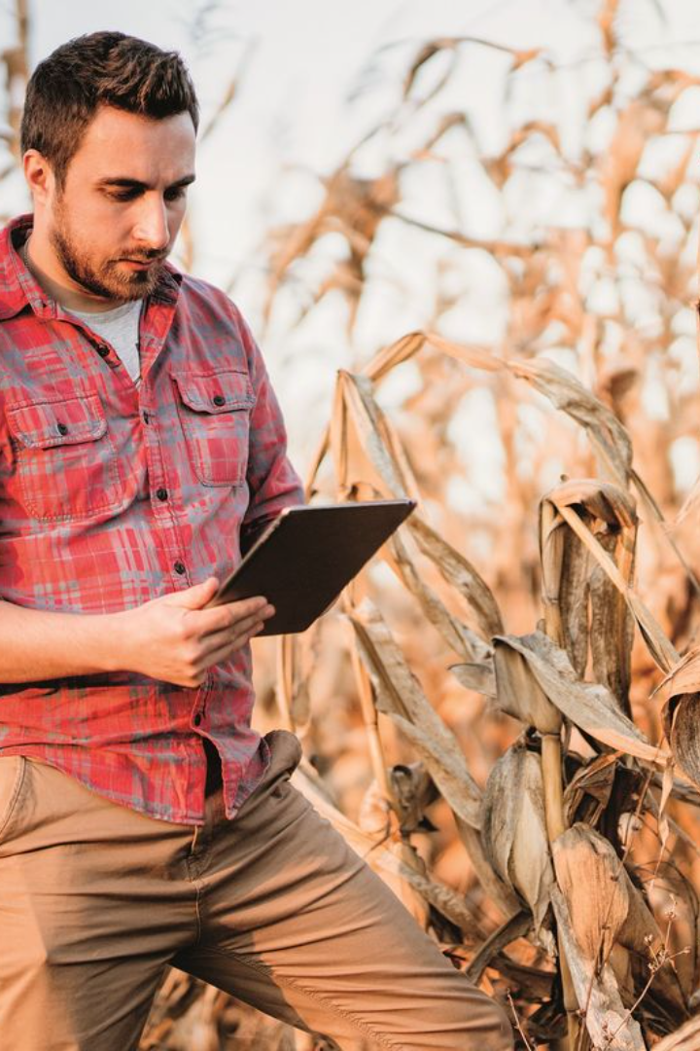
Agrivision: Streamlining Agricultural Operations
By creating an online platform, Agrivision is revolutionizing the way farmers manage their operations. Our platform offers tools to help farmers analyze data, manage inventory, and optimize logistics. With Agrivision, farmers can work more efficiently and make more informed decisions.

Slide 5

Expanding Market Reach with Online Platforms
By establishing an online platform or collaborating with existing agricultural marketplaces, farmers can reach a wider audience and attract diverse buyers. This opens up new opportunities for growth and increases the chances of finding potential buyers looking for their products.

Slide 6

Lack of Market Information
1
Market Price Transparency
Farmers often sell their crops at lower prices due to a lack of information on market rates. Accessible price data empowers farmers to negotiate fair deals.
2
Market Demand Forecasting
Insufficient knowledge about market demand can lead to overproduction or undersupply. Accurate forecasts enable farmers to align their production with demand.
3
Market Access
Restricted access to potential buyers and markets limits farmers' opportunities. Improving market linkages helps farmers connect with buyers directly.

Slide 7

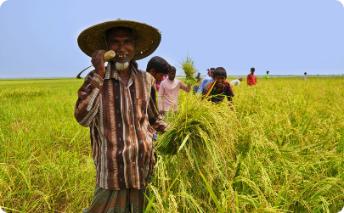

Middlemen Exploitation
Lack of Direct Sales
Unfair Bargaining Power
Delayed Payments
Reliance on middlemen reduces farmers' profit margins. Facilitating direct sales channels enables farmers to earn a fair share of the profits.
Power imbalances in price negotiations disadvantage farmers. Strengthening farmers' bargaining power helps them achieve more equitable agreements.
Delayed payments by middlemen disrupt farmers' financial stability. Ensuring prompt and transparent payment systems is crucial for their economic well-being.

Slide 8

Inadequate Storage Facilities
1
Limited Cold Storage
2
Pest and Rodent Control
Insufficient cold storage facilities result in crop loss and limited shelf life. Expanding storage infrastructure, particularly for perishable crops, is vital.
Lack of effective pest and rodent control measures leads to damage and contamination of stored crops. Investing in pest management techniques minimizes losses.
3
Infrastructure Maintenance
Decaying infrastructure increases the risk of spoilage. Regular maintenance and upgrades are necessary to ensure proper functioning of storage facilities.

Slide 9
Poor Pricing and Payment Systems
Price Manipulation
Payment Delays
Unscrupulous practices by buyers manipulate prices, negatively impacting farmers' revenues. Transparent pricing mechanisms promote fair trade.
Long payment cycles create financial strain for farmers. Efficient payment systems ensure timely and secure transactions for improved livelihoods.
Unfair Deductions
Price Volatility
Unchecked deductions from payments reduce farmers' income. Implementing regulations to prevent unauthorized deductions safeguards their earnings.
Fluctuating prices make it challenging for farmers to plan and budget. Supporting farmers with risk management strategies mitigates price volatility impact.

Slide 10
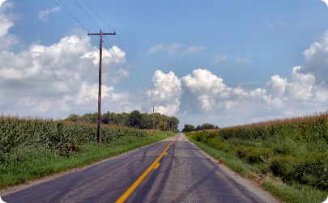
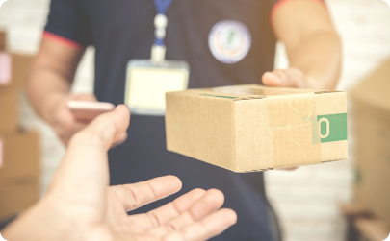

Transportation Challenges
Poor Road Infrastructure
Costly Transportation Services
Limited Logistics Support
Inadequate road connectivity, particularly in rural areas, hinders timely and efficient transportation. Investing in road improvements benefits farmers.
Lack of logistics support for farmers results in inefficiencies and delays. Establishing logistics networks aids smooth and timely transportation.
High transportation costs eat into farmers' profits. Affordable and reliable transportation services reduce the burden on their finances.

Slide 11
Solutions and Recommendations
1
Infrastructure Development
2
Market Information Systems
Investing in storage facilities, transportation networks, and market linkages ensures enhanced agricultural trade and reduced post-harvest losses.
Establishing platforms for real-time price and market information empowers farmers to make informed decisions and negotiate fair prices.
3
Farmer Cooperatives
4
Rural Infrastructure Development
Encouraging the formation of farmer cooperatives strengthens their collective bargaining power and promotes fair trade practices.
Improving rural road networks and providing affordable transportation services facilitates the smooth transfer of crops from farms to markets.

